Slide 1
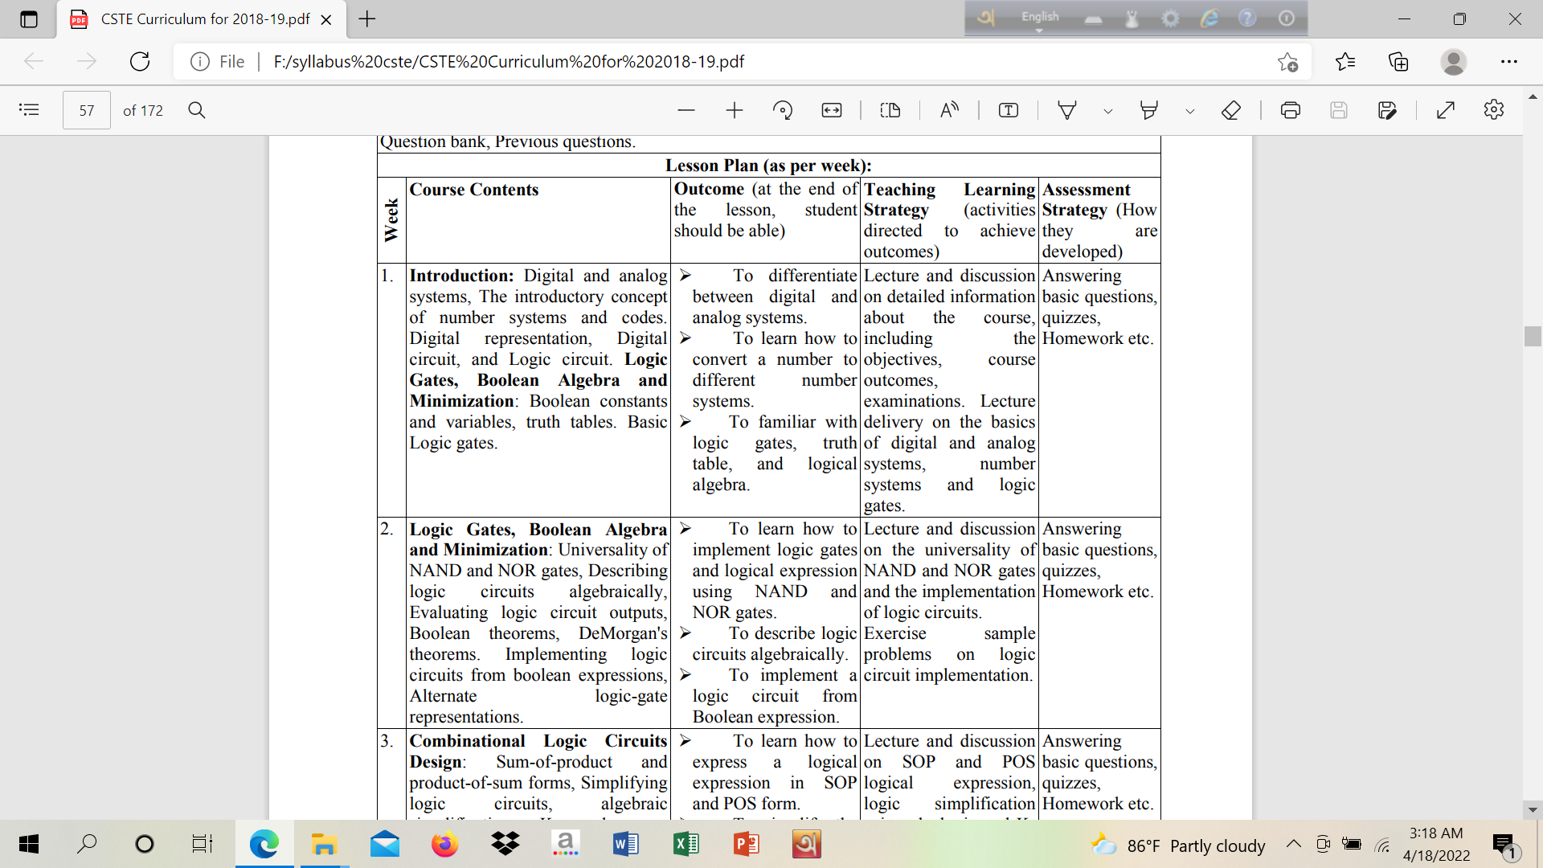

Slide 2
codes

Slide 3
ASCII
Besides numerical data, computer must be able to handle alphabets, punctuation marks, mathematical operators, special symbols etc. that form the complete character set of English language. The complete set of characters or symbols are called alphanumeric codes.
26 upper case letters
26 lower case letters
10 numeric digits
7 punctuation marks
20 to 40 special characters

Slide 4
CODES ASCII
A computer understands only numeric values, whatever the number system used. So all characters must have a numeric equivalent called the alphanumeric code. The most widely used alphanumeric code is American Standard Code for Information Interchange (ASCII). ASCII is a 7-bit code that has 128 (2⁷) possible codes.

Slide 5
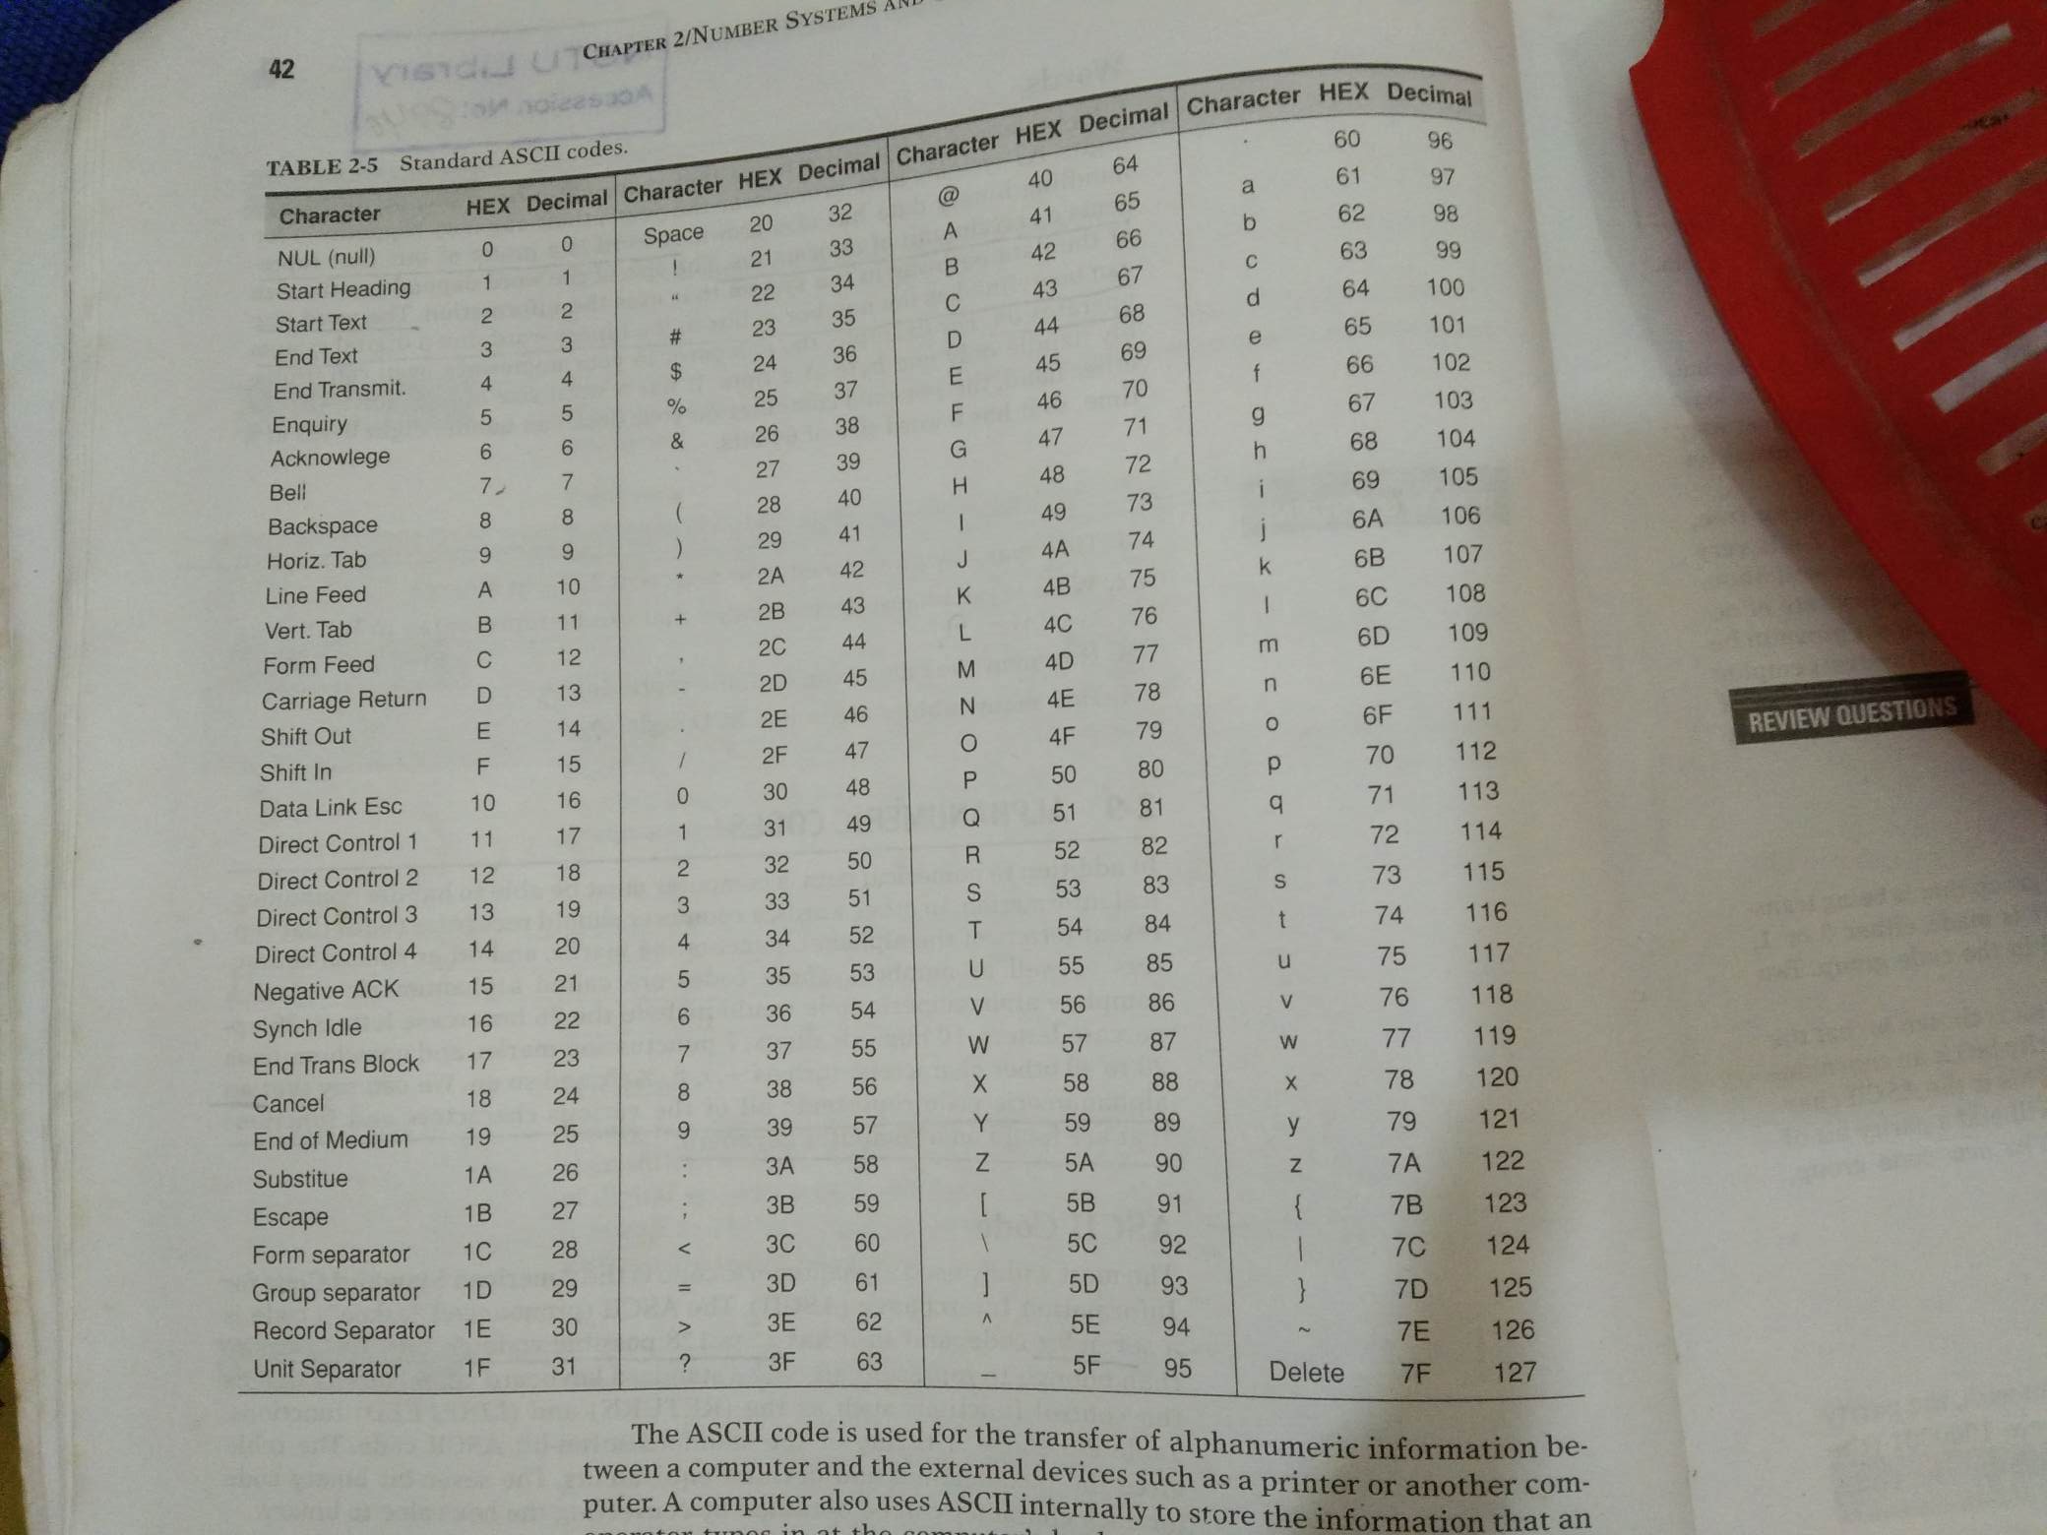
ASCII

Slide 6
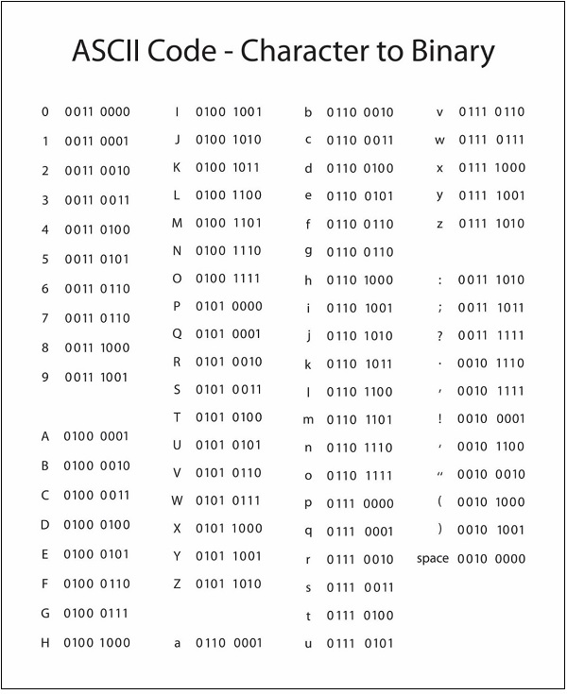
ASCII

Slide 7
Other codes
We know that the bits 0 and 1 corresponding to two different range of analog voltages. So, during transmission of binary data from one system to the other, the noise may also be added. Due to this, there may be errors in the received data at other system.
That means a bit 0 may change to 1 or a bit 1 may change to 0. We can’t avoid the interference of noise. But, we can get back the original data first by detecting whether any errors present and then correcting those errors. For this purpose, we can use the following codes
Error detection codes
Error correction codes

Slide 8
Other codes
Error detection codes − are used to detect the errors present in the received data bit stream. These codes contain some bits, which are included appended to the original bit stream. These codes detect the error, if it is occurred during transmission of the original data bit stream.
Example − Parity code, Hamming code.
Error correction codes − are used to correct the errors present in the received data bit stream so that, we will get the original data. Error correction codes also use the similar strategy of error detection codes. Example − Hamming code.
Therefore, to detect and correct the errors, additional bits are appended to the data bits at the time of transmission.

Slide 9
Parity code
It is easy to include append one parity bit either to the left of MSB or to the right of LSB of original bit stream. There are two types of parity codes, namely even parity code and odd parity code based on the type of parity being chosen.
Even Parity Code:
The value of even parity bit should be zero, if even number of ones present in the binary code. Otherwise, it should be one. So that, even number of ones present in even parity code. Even parity code contains the data bits and even parity bit.

Slide 10
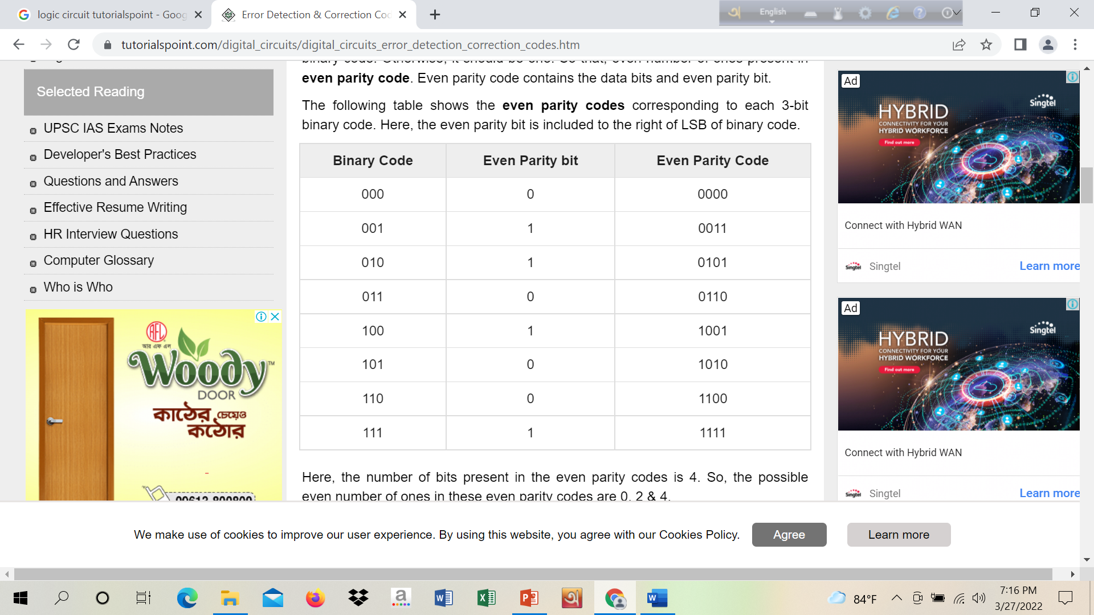
Even parity code
The following table shows the even parity codes corresponding to each 3-bit binary code. Here, the even parity bit is included to the right of LSB of binary code

Slide 11
Even parity code
Here, the number of bits present in the even parity codes is 4.
If the other system receives one of these even parity codes, then there is no error in the received data.
If the other system receives other than even parity codes, then there will be an error in the received data.
Limitation:
In this case, we can’t predict the original binary code because we don’t know the bit positions of error.
Therefore, even parity bit is useful only for detection of error in the received parity code. But, it is not sufficient to correct the error.

Slide 12
Odd parity code
The value of odd parity bit should be zero, if odd number of ones present in the binary code. Otherwise, it should be one. So that, odd number of ones present in odd parity code. Odd parity code contains the data bits and odd parity bit.

Slide 13
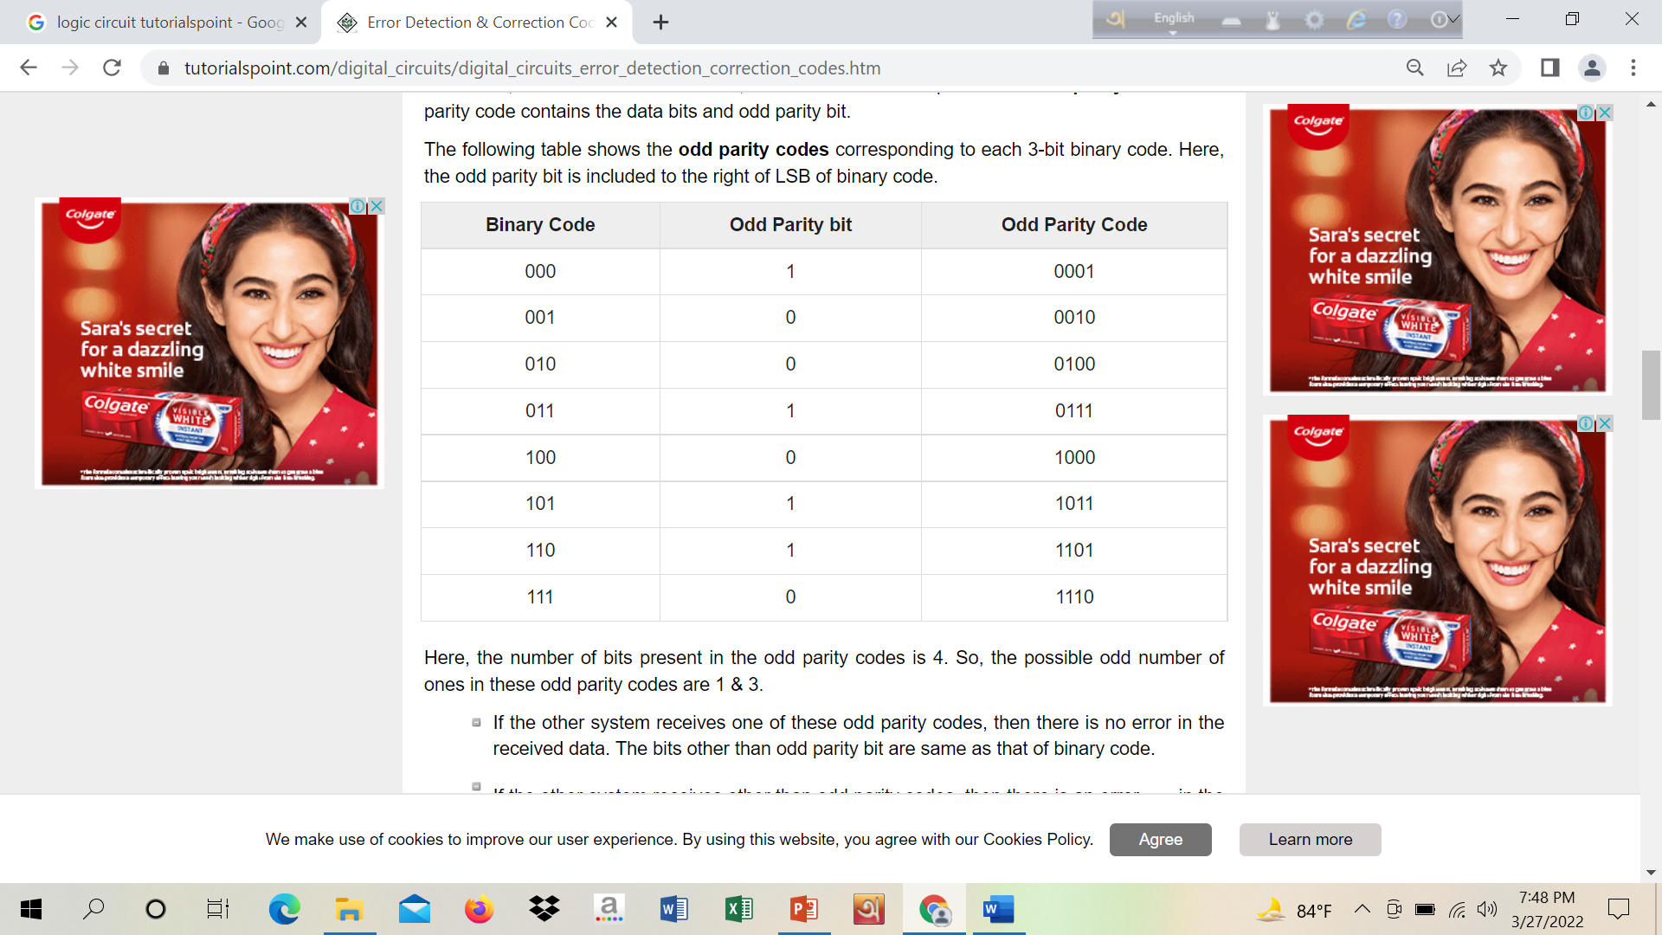
Odd parity
The following table shows the odd parity codes corresponding to each 3-bit binary code. Here, the odd parity bit is included to the right of LSB of binary code. If the other system receives one of these odd parity codes, then there is no error in the received data.

Slide 14
Hamming code
Hamming code is useful for both detection and correction of error present in the received data. This code uses multiple parity bits.

